Slide 1
RUSTikales Rust for beginners

Slide 2
Plan for today

Slide 3
Plan for today
Recap

Slide 4
Plan for today
Recap
Basic Types

Slide 5
Plan for today
Recap
Basic Types
Variables

Slide 6
Recap

Slide 7
Recap
Setup of tools required to start writing Rust code
Rust toolchain
IDE
rust-analyzer

Slide 8
Recap
Setup of tools required to start writing Rust code
rustc → Rust Compiler
The heart of the language
Turns your source code (e.g. main.rs) into an executable

Slide 9
Recap
Setup of tools required to start writing Rust code
rustc → Rust Compiler
cargo → Package Manager
Manages packages (crates), like third-party libraries
Many utility functions such as cargo run or cargo new
Overkill for 99% of the things we‘re doing, but extremely useful in general

Slide 10
Recap
Setup of tools required to start writing Rust code
rustc → Rust Compiler
cargo → Package Manager
rustup → Toolchain Manager
Rust comes in different versions: stable, beta, nightly
Allows us to update the version of the Compiler, or switch to different toolchains (e.g. for cross-compilation)

Slide 11
Recap
Setup of tools required to start writing Rust code
rustc → Rust Compiler
cargo → Package Manager
rustup → Toolchain Manager
cargo new <name> creates a new package in the directory <name>
Unless specified otherwise, it‘s a binary (application) package → Executable
We can then open that directory in an IDE and start programming

Slide 12
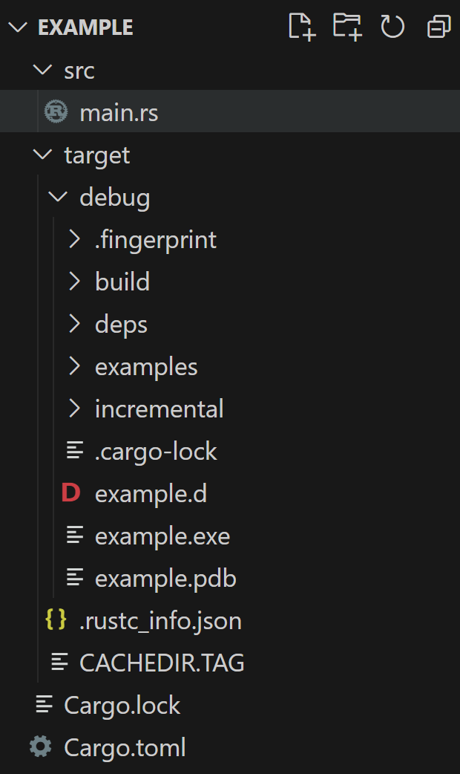
Recap
cargo new example creates this folder structure

Slide 13
Recap
cargo new example creates this folder structure
We will spend most of our time in here
main.rs is where we write code

Slide 14
Recap
cargo new example creates this folder structure
main.rs is where we write code
We can ignore Cargo.lock and Cargo.toml for now
Needed for package dependencies

Slide 15
Recap
cargo new example creates this folder structure
main.rs is where we write code
We can ignore Cargo.lock and Cargo.toml for now
cargo moves the output to the target directory

Slide 16
Recap
cargo new example creates this folder structure
main.rs is where we write code
We can ignore Cargo.lock and Cargo.toml for now
cargo moves the output to the target directory
cargo build creates a debug build
cargo build --release creates a release build
all optimizations enabled

Slide 17
Recap
cargo new example creates this folder structure
main.rs is where we write code
We can ignore Cargo.lock and Cargo.toml for now
cargo moves the output to the target directory
cargo build creates a debug build
cargo build --release creates a release build
you can find the executable here

Slide 18
Recap
cargo new example creates this folder structure
main.rs is where we write code
We can ignore Cargo.lock and Cargo.toml for now
cargo moves the output to the target directory
cargo build creates a debug build
cargo build --release creates a release build
cargo run [--release] builds the project and runs it

Slide 19
Basic Types

Slide 20
Basic Types
Rust is a statically typed language
Every variable and every value has exactly one type
Type must be known at compile time
You can‘t change that type

Slide 21
Basic Types
Rust is a statically typed language
The compiler statically type checks your code

Slide 22
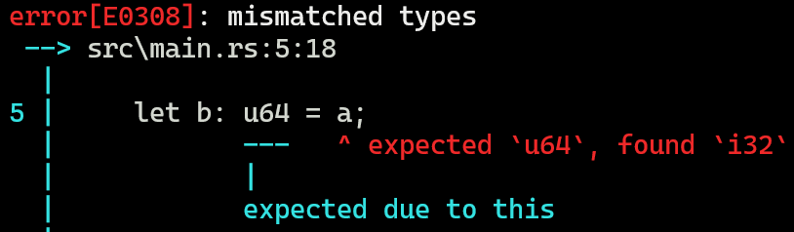
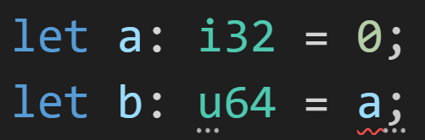
Basic Types
Rust is a statically typed language
The compiler statically type checks your code
Finds type errors such as
Assigning an i32 to an u64

Slide 23
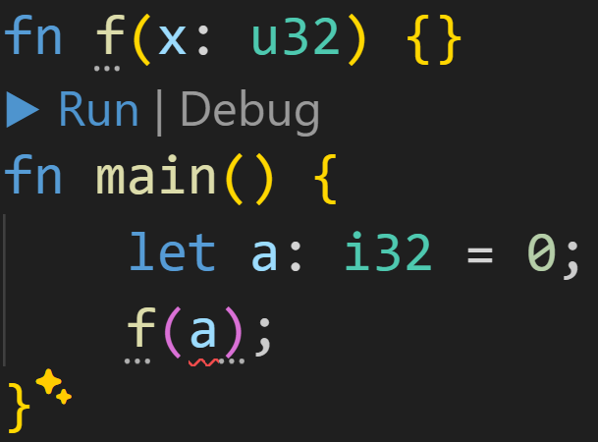
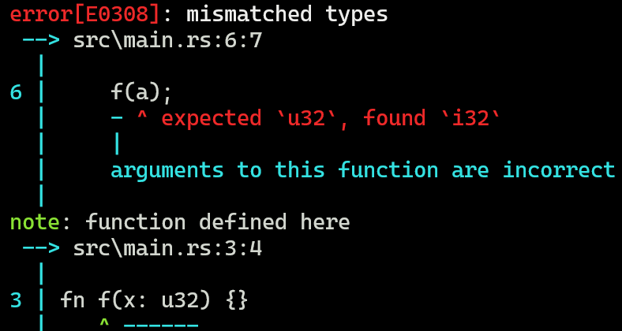
Basic Types
Rust is a statically typed language
The compiler statically type checks your code
Finds type errors such as
Assigning an i32 to an u64
Passing an i32 where a u32 was expected

Slide 24
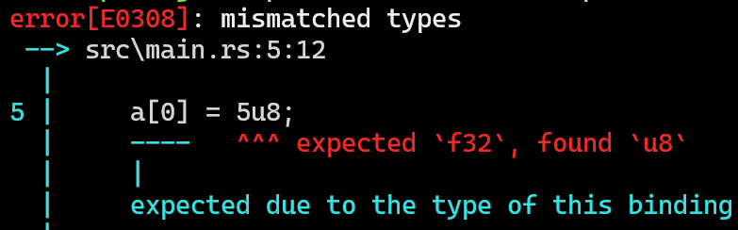
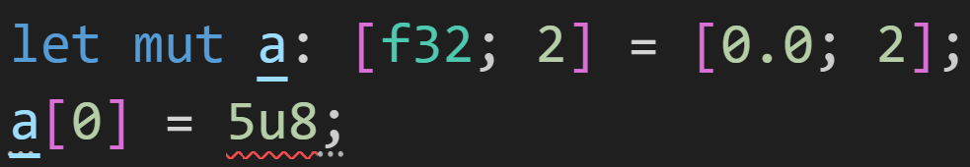
Basic Types
Rust is a statically typed language
The compiler statically type checks your code
Finds type errors such as
Assigning an i32 to an u64
Passing an i32 where a u32 was expected
Inserting an u8 into an array of f32

Slide 25
Basic Types
Rust is a statically typed language
The compiler statically type checks your code
Very useful, because we can easily reason about our code, and prevent many bugs
Types are always known, and not changeable
Contrast to variables in dynamic languages
Assign any value to any variable at any point
Hope it doesn‘t crash at runtime

Slide 26
Basic Types
Rust has many different types

Slide 27
Basic Types
Rust has many different types
Scalar types → Represent single values

Slide 28
Basic Types
Rust has many different types
Scalar types → Represent single values
Integer → whole numbers, signed or unsigned
Floating Point → fractions, big numbers
boolean → either true or false
character → Unicode → abcäøóáßð😊😍

Slide 29
Basic Types
Rust has many different types
Scalar types → Represent single values
Compound types → Combinations of types

Slide 30
Basic Types
Rust has many different types
Scalar types → Represent single values
Compound types → Combinations of types
array → Fixed length collection of values of the same type
tuple → Fixed length collection of values of (possibly) different types
struct → User-defined collections of values

Slide 31
Basic Types
Rust has many different types
Today we will only look at integers, other types will be introduced later

Slide 32
Basic Types
Rust has many different types
Rust has clear names for integer types

Slide 33
Basic Types
Rust has many different types
Rust has clear names for integer types
Letter indicates signed or unsigned
Number indicates size in bits

Slide 34
Basic Types
Rust has many different types
Rust has clear names for integer types
Letter indicates signed or unsigned
Number indicates size in bits
u8 is an unsigned 8bit integer
i32 is a signed 32bit integer
u16 is an unsigned 16bit integer

Slide 35
Basic Types
Rust has many different types
Rust has clear names for integer types
The bitsize shows how big a number can be
More bits, bigger numbers
32bits can store numbers as big as 2^32-1 = 4.294.967.295
Bigger numbers require more space in memory

Slide 36
Basic Types
Rust has many different types
Rust has clear names for integer types
The bitsize shows how big a number can be
signed means the number can be negative
one bit needed to specify the sign, so the number range is smaller
i32 can not represent 4.294.967.295
i32 can represent -420

Slide 37
Basic Types
Rust has many different types
Rust has clear names for integer types
The bitsize shows how big a number can be
signed means the number can be negative
Type | Meaning | Min Value | Max Value
i8 | signed 8bit | -(2^7) = -128 | 2^7-1 = 127
u8 | unsigned 8bit | 0 | 2^8-1 = 255
i16 | signed 16bit | -(2^15) = -32768 | 2^15-1 = 32767
u16 | unsigned 16bit | 0 | 2^16-1 = 65535
The pattern repeats up to i128 and u128, doubling the amount of bits every time

Slide 38
Basic Types
Rust also has types isize and usize
Target machine dependent size
64bit machine → 64bit wide
32bit machine → 32bit wide

Slide 39
Basic Types
Rust also has types isize and usize
Target machine dependent size
64bit machine → 64bit wide
32bit machine → 32bit wide
Does anyone know why?
3/3

Slide 40
Basic Types
Rust also has types isize and usize
Target machine dependent size
64bit machine → 64bit wide
32bit machine → 32bit wide
Does anyone know why?
Used for indexing, sizes, offsets
Everything involving memory and pointer arithmetics
32bit systems can‘t make use of 64bit memory addresses → Must be flexible
3/3

Slide 41
Basic Types
Rust also has types isize and usize
Target machine dependent size
64bit machine → 64bit wide
32bit machine → 32bit wide
If you want to index into an array or vector, your index needs to be of type usize

Slide 42
Variables

Slide 43
Variables
Variables are a very fundamental part in programming
They allow us to store values in memory for later use

Slide 44
Variables
Variables are a very fundamental part in programming
Variables are declared using the keyword let

Slide 45
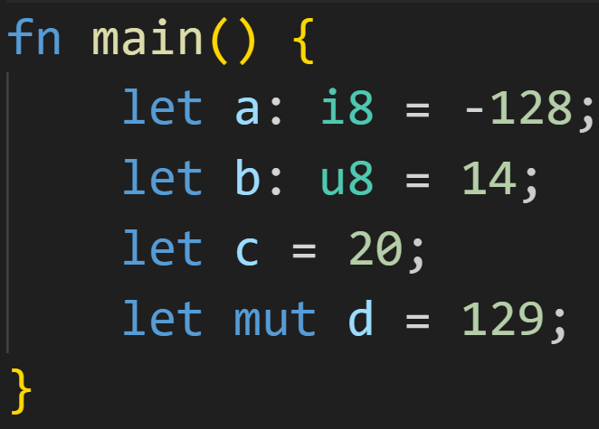
Variables
Variables are a very fundamental part in programming
Variables are declared using the keyword let

Slide 46
Variables
Variables are a very fundamental part in programming
Variables are declared using the keyword let
Declarations always follow the same rule:

Slide 47
Variables
Variables are a very fundamental part in programming
Variables are declared using the keyword let
Declarations always follow the same rule:
let

Slide 48
Variables
Variables are a very fundamental part in programming
Variables are declared using the keyword let
Declarations always follow the same rule:
let [mut]

Slide 49
Variables
Variables are a very fundamental part in programming
Variables are declared using the keyword let
Declarations always follow the same rule:
let [mut] name

Slide 50
Variables
Variables are a very fundamental part in programming
Variables are declared using the keyword let
Declarations always follow the same rule:
let [mut] name [:Type]

Slide 51
Variables
Variables are a very fundamental part in programming
Variables are declared using the keyword let
Declarations always follow the same rule:
let [mut] name [:Type] = Expression;

Slide 52
Variables
Variables are a very fundamental part in programming
Variables are declared using the keyword let
Declarations always follow the same rule:
let [mut] name [:Type] = Expression;
→ mut indicates the mutability of a variable

Slide 53
Variables
Variables are a very fundamental part in programming
Variables are declared using the keyword let
Declarations always follow the same rule:
let [mut] name [:Type] = Expression;
→ mut indicates the mutability of a variable
→ Type Inference infers the type based on the context in which the variable is used

Slide 54
Variables
Variables are a very fundamental part in programming
Variables are declared using the keyword let
This code snippet creates four variables
Name | Mutable | Type | Value
a | no | i8 | -128
b | no | u8 | 14
c | no | i32 (inferred) | 20
d | yes | i32 (inferred) | 129

Slide 55
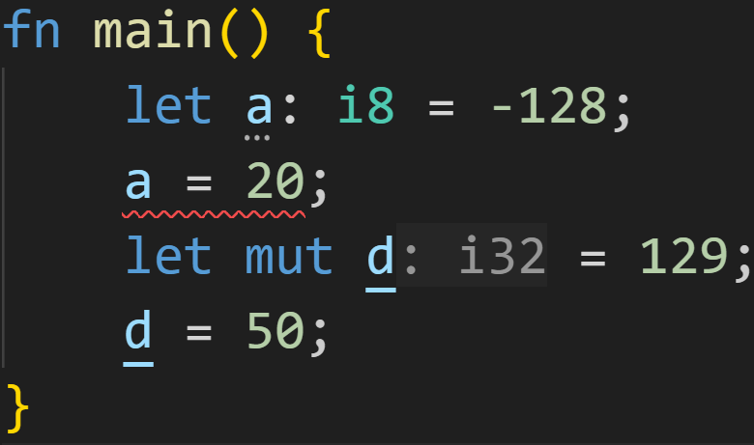
Variables
Variables are a very fundamental part in programming
Variables are declared using the keyword let
Using the keyword mut, we can make our variables mutable

Slide 56
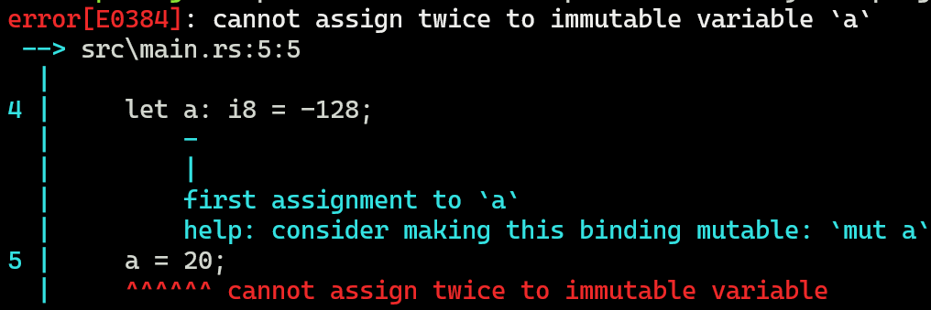
Variables
Variables are a very fundamental part in programming
Variables are declared using the keyword let
Using the keyword mut, we can make our variables mutable
Immutable, we can‘t re-assign to the variable

Slide 57
Variables
Variables are a very fundamental part in programming
Variables are declared using the keyword let
Using the keyword mut, we can make our variables mutable
Mutable, we can re-assign to the variable

Slide 58
Variables
Variables are a very fundamental part in programming
Variables are declared using the keyword let
Using the keyword mut, we can make our variables mutable
rust-analyzer shows us inferred types

Slide 59
Variables
Variables are a very fundamental part in programming
Variables are declared using the keyword let
Using the keyword mut, we can make our variables mutable
Why does Rust have that system? What do we gain from making variables [im]mutable?
3/3

Slide 60
Variables
Variables are a very fundamental part in programming
Variables are declared using the keyword let
Using the keyword mut, we can make our variables mutable
Why does Rust have that system? What do we gain from making variables [im]mutable?
Easier to reason your code, make it explicit what you‘re expecting to change
Very useful when we get to references and the borrow checker
Prevents a lot of bugs and oversights
TLDR: More control over what is happening
3/3

Slide 61
Variables
Variables are a very fundamental part in programming
Variables are declared using the keyword let
Using the keyword mut, we can make our variables mutable
When we assign values to variables, two things can happen:
The value is copied
The value is moved
Will be covered when we talk about Ownership

Slide 62
Intermission - How a program is executed

Slide 63
Intermission - How a program is executed
Understanding how a computer executes code helps with writing better programs
We‘ll skip over all technical details, and how the source code turns into machine code

Slide 64
Intermission - How a program is executed
Understanding how a computer executes code helps with writing better programs
Computers process instructions sequentially, one after the other
Fetch → Decode → Execute

Slide 65
Intermission - How a program is executed
Understanding how a computer executes code helps with writing better programs
Computers process instructions sequentially, one after the other
On a high level, we specify what these instructions should be
All the fancy steps in the middle just turn human-readable into machine-executable

Slide 66
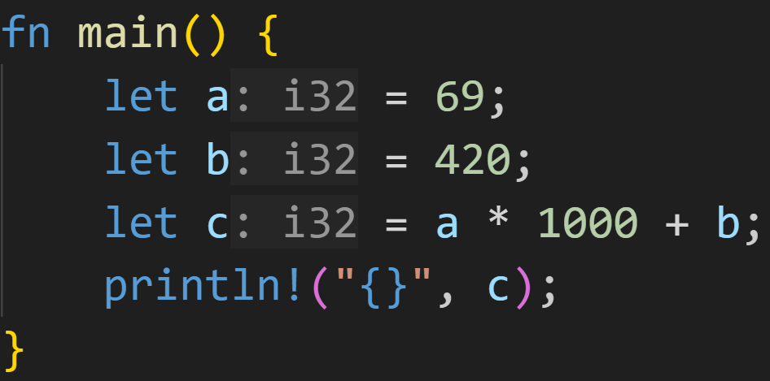
Intermission - How a program is executed

Slide 67
Intermission - How a program is executed
First, store 69 in a

Slide 68
Intermission - How a program is executed
First, store 69 in a
Then, store 420 in b

Slide 69
Intermission - How a program is executed
First, store 69 in a
Then, store 420 in b
Read a, multiply its value by 1000

Slide 70
Intermission - How a program is executed
First, store 69 in a
Then, store 420 in b
Read a, multiply its value by 1000
Read b, add its value to the result of step 3

Slide 71
Intermission - How a program is executed
First, store 69 in a
Then, store 420 in b
Read a, multiply its value by 1000
Read b, add its value to the result of step 3
Store the result of step 4 in c

Slide 72
Intermission - How a program is executed
First, store 69 in a
Then, store 420 in b
Read a, multiply its value by 1000
Read b, add its value to the result of step 3
Store the result of step 4 in c
Read c, print its value to the console

Slide 73
Intermission - How a program is executed
Understanding how a computer executes code helps with writing better programs
Computers process instructions sequentially, one after the other
On a high level, we specify what these instructions should be
A memory table can help understand what the computer does

Slide 74
Intermission - How a program is executed
Variable | Type | Value
a | i32 | ???
b | i32 | ???
c | i32 | ???
temp* | i32 | ???

Slide 75
Intermission - How a program is executed
Variable | Type | Value
a | i32 | 69
b | i32 | ???
c | i32 | ???
temp* | i32 | ???

Slide 76
Intermission - How a program is executed
Variable | Type | Value
a | i32 | 69
b | i32 | 420
c | i32 | ???
temp* | i32 | ???

Slide 77
Intermission - How a program is executed
Variable | Type | Value
a | i32 | 69
b | i32 | 420
c | i32 | ???
temp* | i32 | 69*1000=69.000

Slide 78
Intermission - How a program is executed
Variable | Type | Value
a | i32 | 69
b | i32 | 420
c | i32 | 69.000+420=69.420
temp* | i32 | 69.000

Slide 79

Intermission - How a program is executed
Variable | Type | Value
a | i32 | 69
b | i32 | 420
c | i32 | 69.420
temp* | i32 | 69.000

Slide 80
Intermission - How a program is executed
Understanding how a computer executes code helps with writing better programs
Computers process instructions sequentially, one after the other
On a high level, we specify what these instructions should be
A memory table can help understand what the computer does
very helpful to create one for exercises that compile
go step by step through the program, do you get the same output as the computer?

Slide 81
Intermission - How a program is executed
Understanding how a computer executes code helps with writing better programs
Computers process instructions sequentially, one after the other
On a high level, we specify what these instructions should be
A memory table can help understand what the computer does
Best debugging advice:
Go through your program, step by step, and pretend you‘re the computer
if something doesn‘t make sense to you, that‘s usually where the bug is

Slide 82
Intermission - How a program is executed
Understanding how a computer executes code helps with writing better programs
Computers process instructions sequentially, one after the other
On a high level, we specify what these instructions should be
A memory table can help understand what the computer does
Best debugging advice:
Go through your program, step by step, and pretend you‘re the computer
if something doesn‘t make sense to you, that‘s usually where the bug is
🦆: https://en.wikipedia.org/wiki/Rubber_duck_debugging

Slide 83
Intermission - How a program is executed
Understanding how a computer executes code helps with writing better programs
Computers process instructions sequentially, one after the other
On a high level, we specify what these instructions should be
A memory table can help understand what the computer does
Best debugging advice:
Go through your program, step by step, and pretend you‘re the computer
if something doesn‘t make sense to you, that‘s usually where the bug is
🦆: https://en.wikipedia.org/wiki/Rubber_duck_debugging
Programming involves a lot of logic and reasoning
in theory → How computers work, how programming languages work
in practice → What I want my computer to do, and when, and how

Slide 84
Intermission - How a program is executed
Understanding how a computer executes code helps with writing better programs
Computers process instructions sequentially, one after the other
On a high level, we specify what these instructions should be
A memory table can help understand what the computer does
Best debugging advice:
Go through your program, step by step, and pretend you‘re the computer
if something doesn‘t make sense to you, that‘s usually where the bug is
🦆: https://en.wikipedia.org/wiki/Rubber_duck_debugging
Programming involves a lot of logic and reasoning
in theory → How computers work, how programming languages work
in practice → What I want my computer to do, and when, and how
Better programming skills → Better logical thinking and reasoning skills, and vice versa

Slide 85
Intermission - Exercise
Time for exercises!

Slide 86
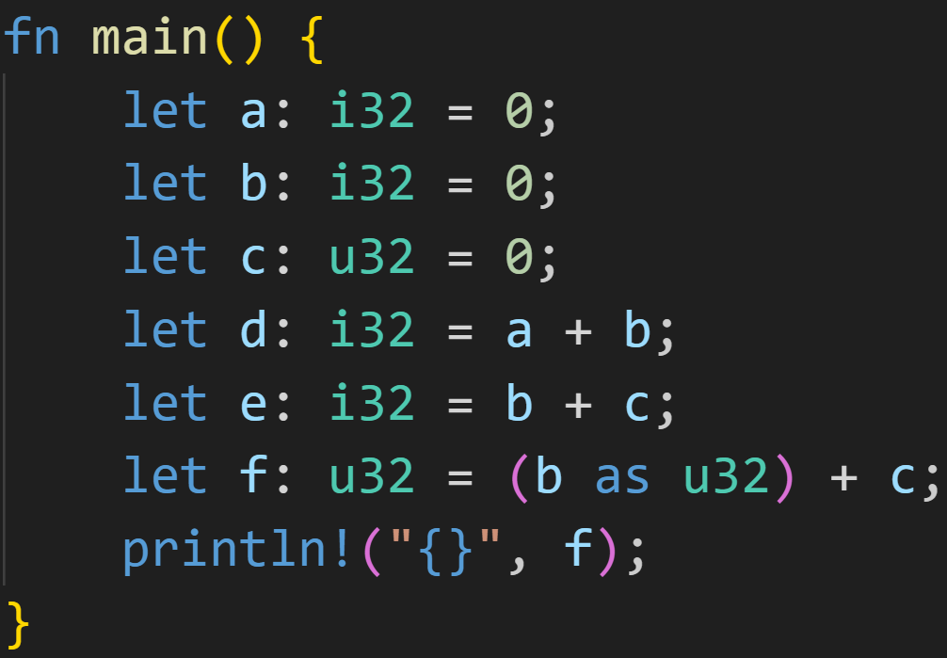
Intermission - Exercise
1/3

Slide 87
Intermission - Exercise
1/3
Does this code compile? If yes, what does it print?

Slide 88
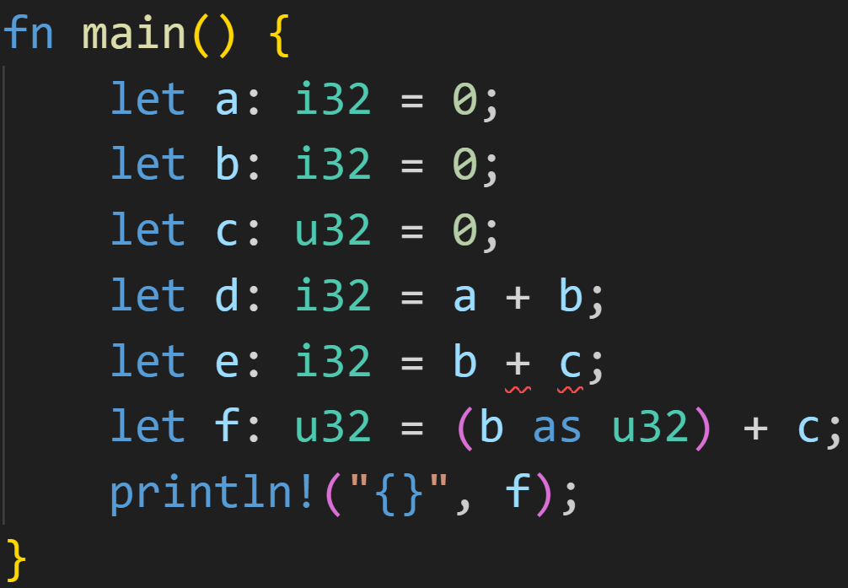
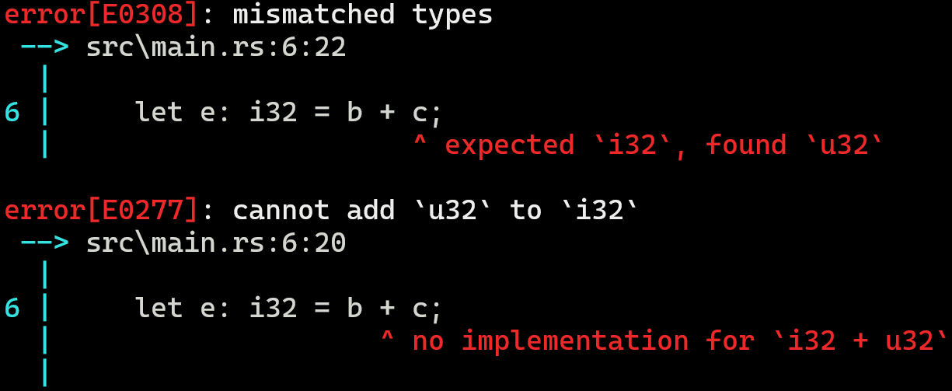
Intermission - Exercise
1/3
Does this code compile? If yes, what does it print?
Nope, you can‘t add i32 and u32 :^)

Slide 89
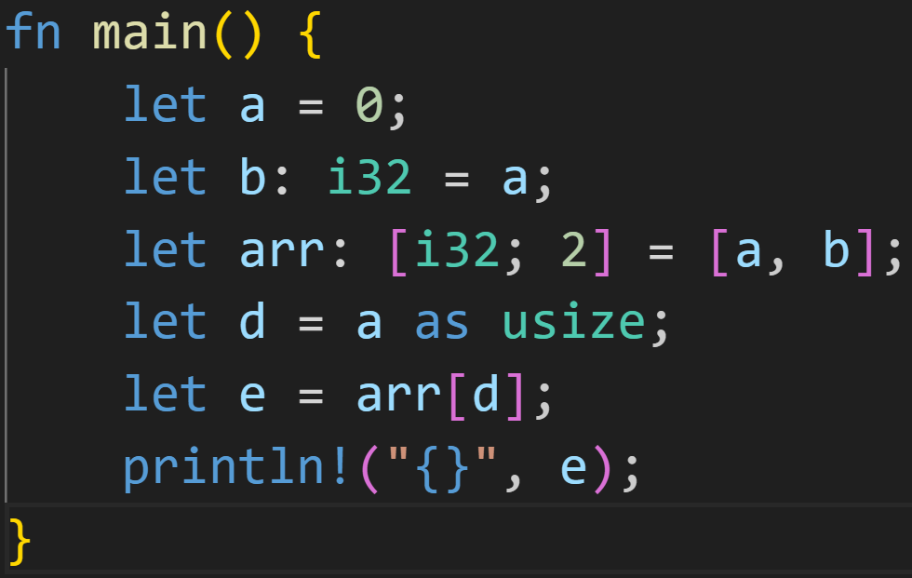
Intermission - Exercise
2/3

Slide 90
Intermission - Exercise
2/3
Does this code compile? What type does a have?
What type does d have?
What type does e have?

Slide 91
Intermission - Exercise
2/3
Does this code compile? What type does a have?
What type does d have?
What type does e have?
It does compile!
The compiler was able to figure out the types for all variables!

Slide 92
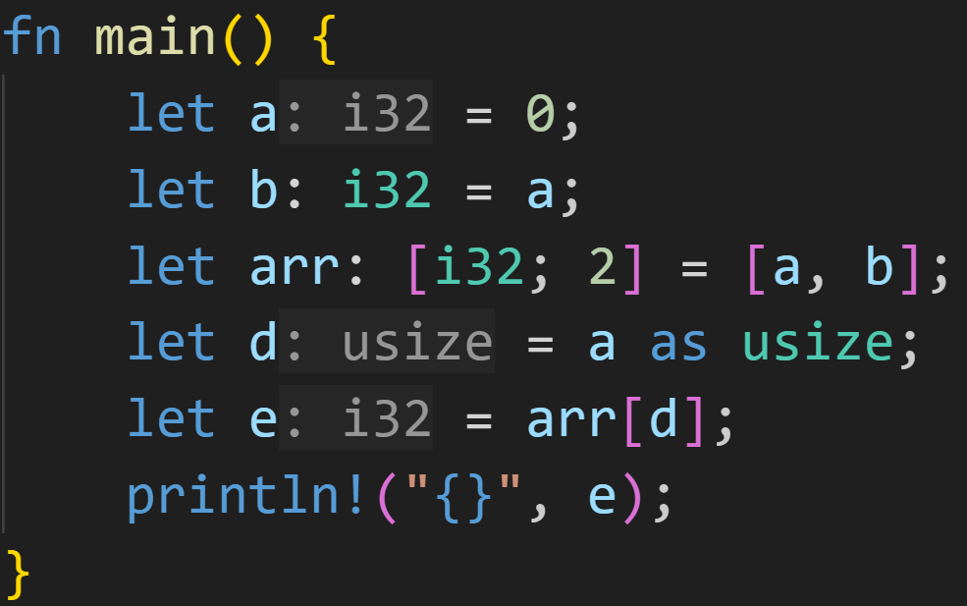
Intermission - Exercise
2/3
Does this code compile? What type does a have?
What type does d have?
What type does e have?
It does compile!
The compiler was able to figure out the types for all variables!
Variable a is of type i32
→ used in the context of b
Variable d is of type usize
→ Read a, take its value, interpret as usize
Variable e is of type i32
→ Arrays will be covered next time, but all elements of arr are of type i32

Slide 93
Next time
Arrays
Vectors

